Slide 1
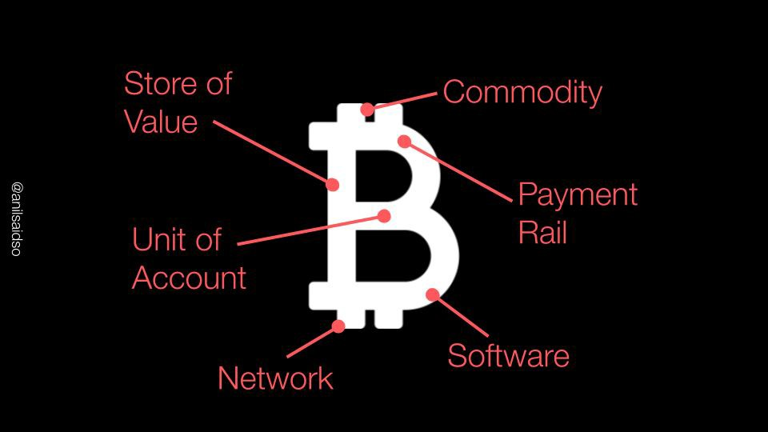










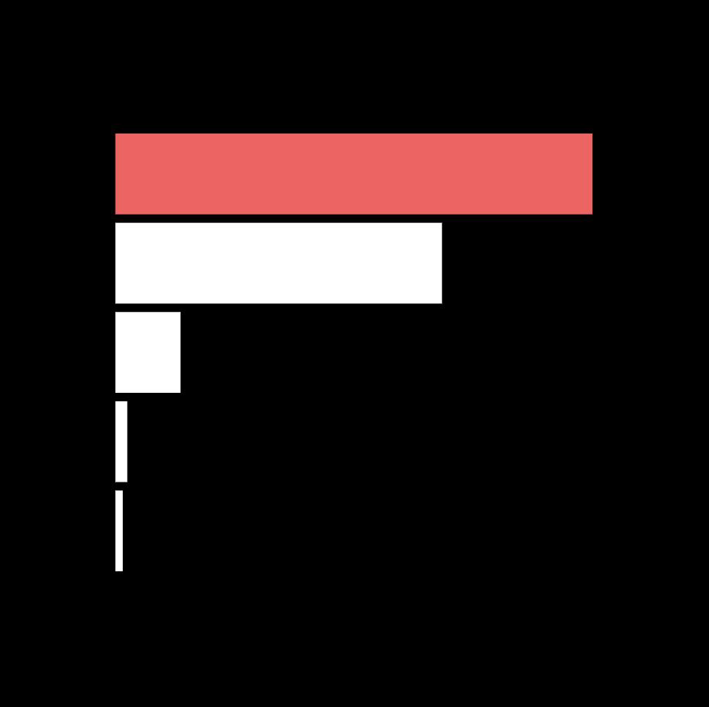

The Bitcoin Handbook PRESENTATION DECK
Anil Patel

Slide 2
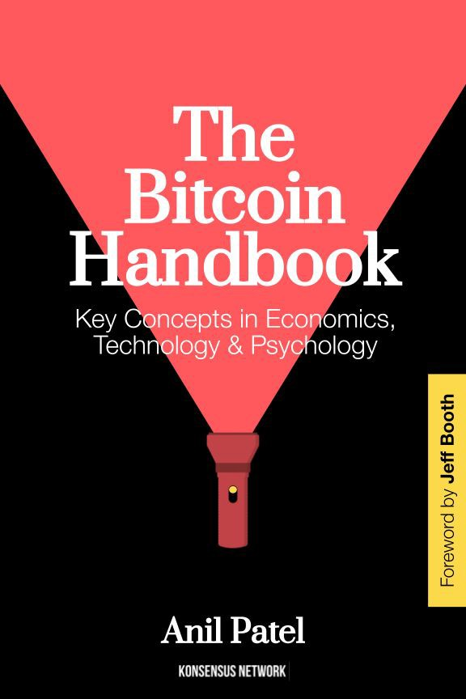


This deck is adapted from the book:
Anil
@anilsaidso

Slide 3
Contents
I. Economics
II. Technology & Systems
III. Psychology
Scarcity
Monetary Premium
Gresham’s Law
Thier’s Law
Cantillon Effect
Schelling Point
Opportunity Cost
Time Preference
Impossible Trinity
Jevons Paradox
Power Laws
Winner-Take-All Effects
Unit Bias
Veblen Good
Malinvestment
Asymmetric Payoff
Ansoff Matrix
Gartner Hype Cycle
Amara’s Law
Orders of Magnitude
10x Improvement Rule
Network Effects
Churn
Accelerating Returns
Higher-Order Effects
Creative Destruction
Feedback Loops
Reflexivity
Relativity
Thermodynamics 1st law
Thermodynamics 2nd law
Information Theory
Arrow of Time
Moore’s Law
Antifragility
Gall’s Law
Attack Surface
Catalysts
Friction
Prisoner’s Dilemma
Jurisdictional Arbitrage
Social Proof
Mimetic Theory
First Conclusion Bias
Circle of Competence
Dunning-Kruger Effect
Category Error
Intransigent Minority
Inequivalence Theorem
Gell-Mann Amnesia
Lindy Effect
Emergence
Streisand Effect
Moral Hazard
Counterparty Risk

Slide 4
Economics

Slide 5
SCARCITY
The Bitcoin Handbook
How limited resources are allocated and competed for
@anilsaidso

Slide 6
$21.3T
₿21M
US M2
Money Supply
1960-2022
@anilsaidso
Bitcoin SUPPLY
SCHEDULE
2009-2140
0
0

Slide 7
MONETARY PREMIUM
The Bitcoin Handbook
Purchasing power of a monetary good in excess of its use-value alone
@anilsaidso

Slide 8
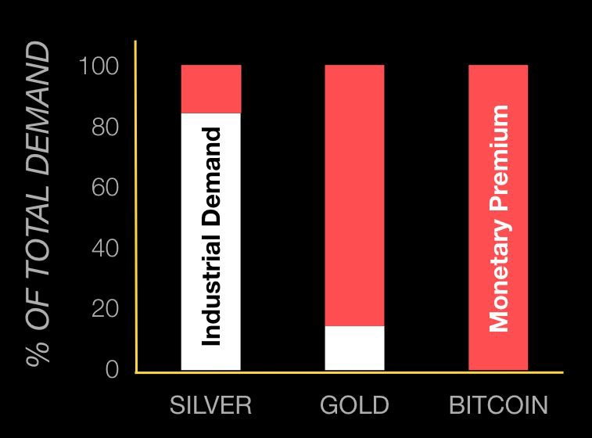
@anilsaidso
source: ‘The Bullish Case for Bitcoin’ by Vijay Boyapati

Slide 9
GRESHAM’S LAW
The Bitcoin Handbook
When two forms of commodity money are decreed with equivalent face value, the more valuable commodity will be saved— disappearing from circulation.
@anilsaidso

Slide 10
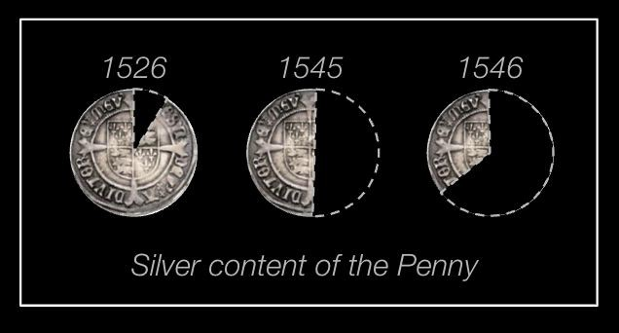
@anilsaidso
More valuable
Less valuable

Slide 11

THIER’S LAW
The Bitcoin Handbook
Absent legal tender laws, money that cannot be relied upon to preserve value will be rejected
in favor of superior forms.
@anilsaidso

Slide 12
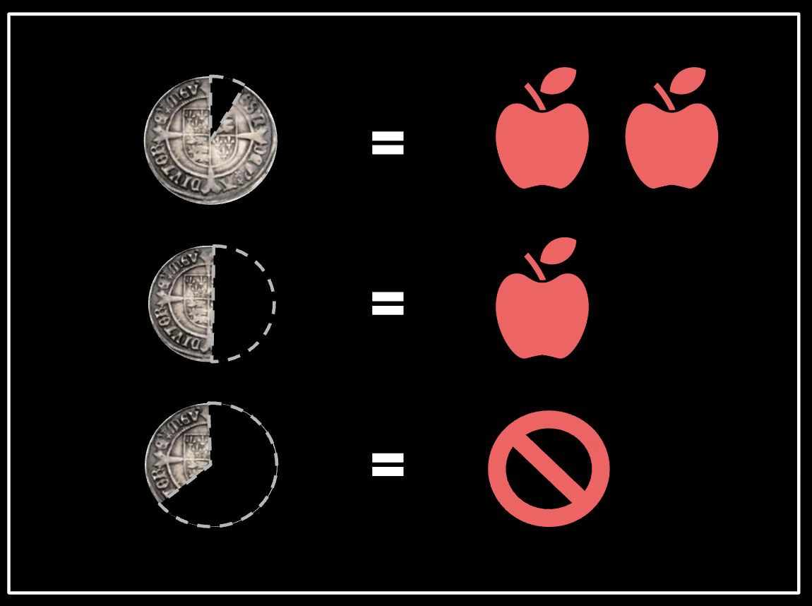
@anilsaidso

Slide 13

CANTILLON EFFECT
The Bitcoin Handbook
New units of money create disproportionate price inﬂation when added into an economy based on the path they travel
@anilsaidso

Slide 14
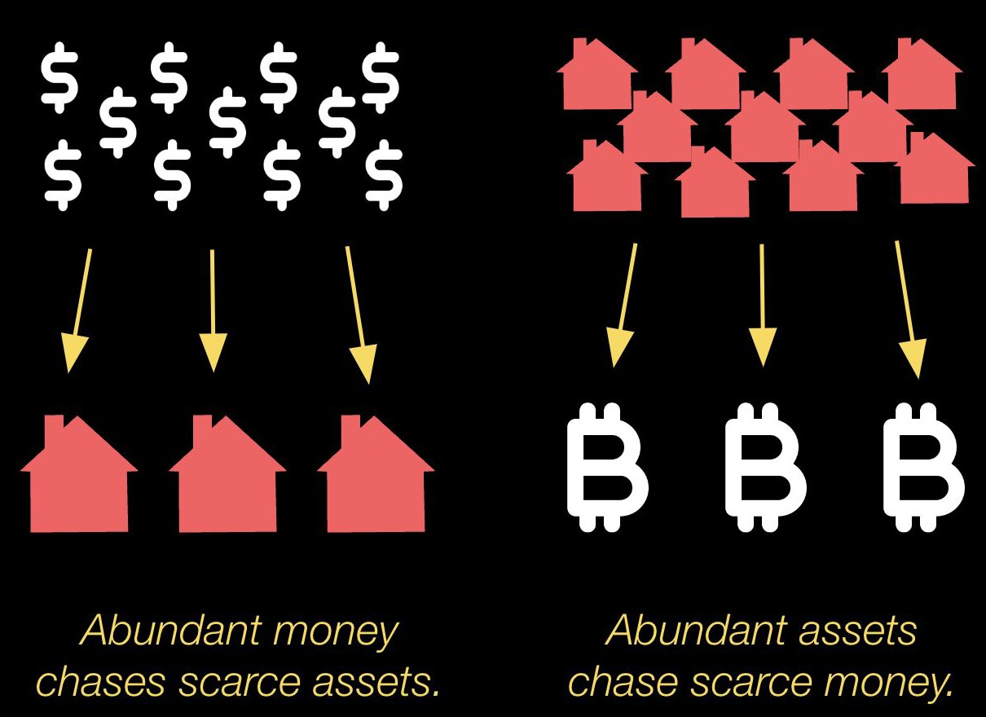
@anilsaidso

Slide 15
SCHELLING POINT
The Bitcoin Handbook
A solution that people tend to choose, by default, in the absence of communication
@anilsaidso

Slide 16
OPPORTUNITY COST
The Bitcoin Handbook
When doing one thing comes at the cost of not being able to do something else
@anilsaidso

Slide 17
“When money is hard and can appreciate, individuals are likely to be very discerning about what they spend it on, as the opportunity cost appreciates over time.”
—SAIFEDEAN AMMOUS

Slide 18

TIME PREFERENCE
The Bitcoin Handbook
The degree to which someone values the present relative
to the future
@anilsaidso

Slide 19
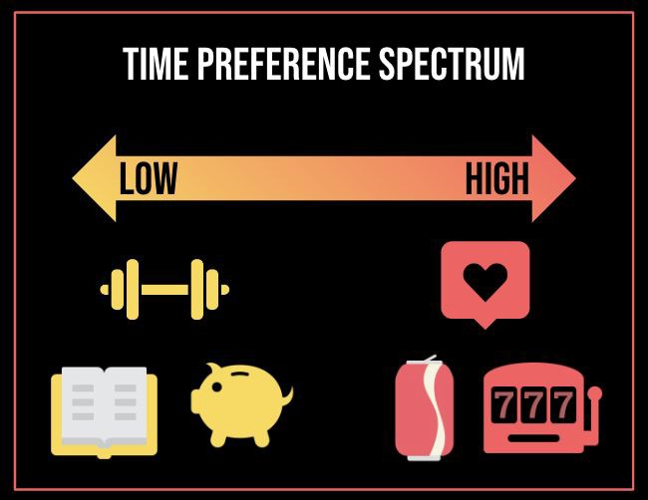
@anilsaidso

Slide 20
IMPOSSIBLE TRINITY
The Bitcoin Handbook
A sovereign nation cannot simultaneously have free capital ﬂows, independent monetary policy and a ﬁxed exchange rate
@anilsaidso

Slide 21
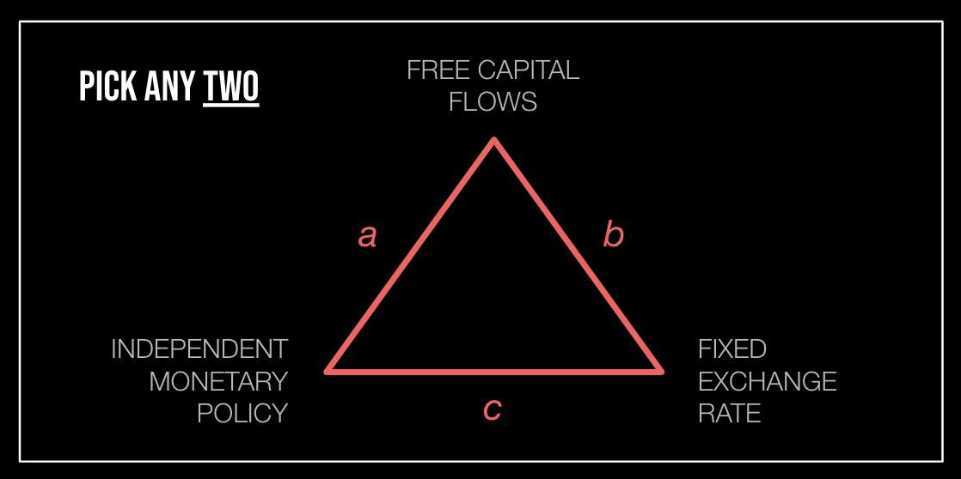
@anilsaidso

Slide 22
JEVONS PARADOX
The Bitcoin Handbook
The observation that consumption of a resource increases when eﬃciency gains are achieved through its use
@anilsaidso

Slide 23
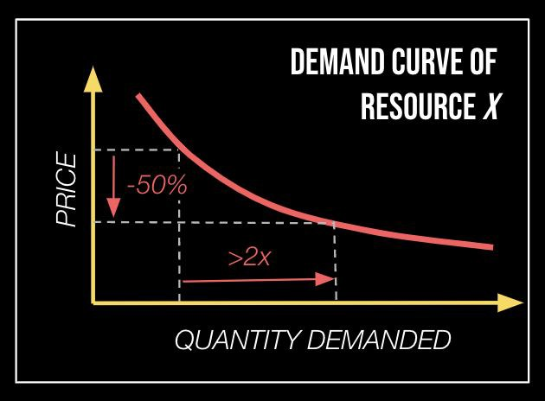
@anilsaidso

Slide 24
POWER LAWS
The Bitcoin Handbook
Relationships between two quantities, where changes to one leads to a proportional relative change to the other.
@anilsaidso

Slide 25
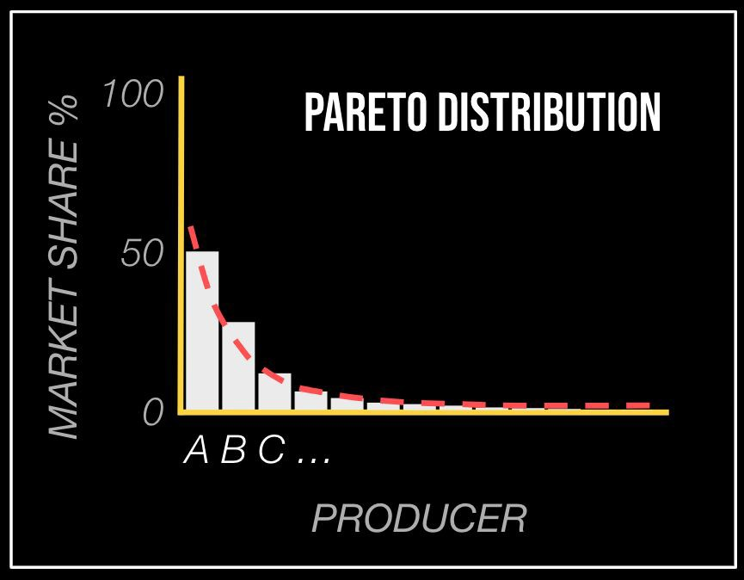
@anilsaidso

Slide 26

WINNER-TAKE-ALL MARKETS
The Bitcoin Handbook
Competitions where the single best performer captures the entire reward on oﬀer
@anilsaidso

Slide 27


@anilsaidso

Slide 28
“Money is a network.
Some networks are singular (i.e., winner-takes-all).
Money is such a network.”
—GIGI

Slide 29

UNIT BIAS
The Bitcoin Handbook
The faulty reasoning that a single unit must be the appropriate amount from which to make assessments and comparisons
@anilsaidso

Slide 30

YOU CAN BUY A
@anilsaidso
FRACTION OF A BITCOIN

Slide 31

VEBLEN GOOD
The Bitcoin Handbook
Types of goods where the quantity demanded increases as the price increases
@anilsaidso

Slide 32
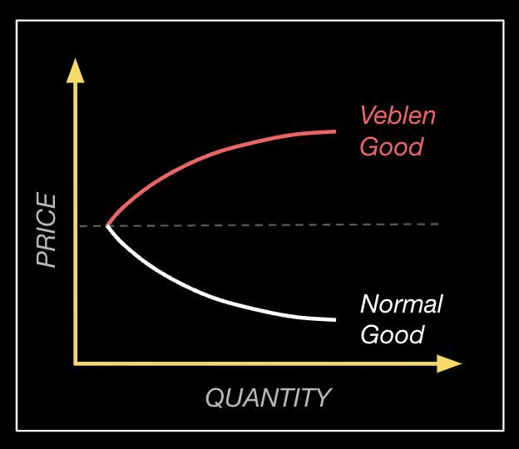
@anilsaidso

Slide 33

MALINVESTMENT
The Bitcoin Handbook
Distorted price signals cause a misallocation of capital towards less productive uses than would otherwise be chosen under a free market
@anilsaidso

Slide 34
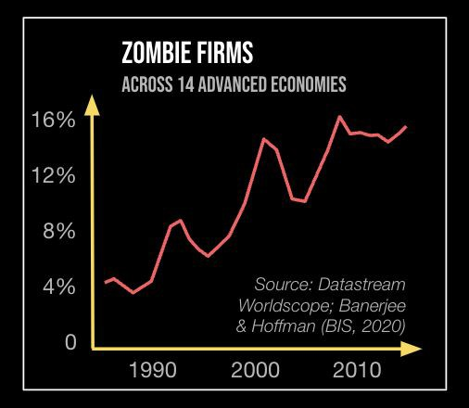
@anilsaidso

Slide 35
ASYMMETRIC PAYOFF
The Bitcoin Handbook
Investment decisions where the potential upside is disproportionately greater than the downside risk
@anilsaidso

Slide 36
“We can debate whether or not bitcoin is going to be a big deal in the future.
But I don’t think we can debate that if it is it’s going to have an enormous right tail.”
—ROSS STEVENS

Slide 37
Price ($)
Probability
@anilsaidso

Slide 38




ANSOFF MATRIX
The Bitcoin Handbook
A strategic framework for growth opportunities of a product across lines and markets
@anilsaidso

Slide 39
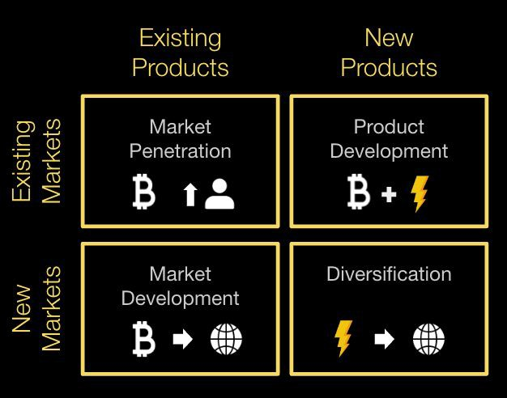
@anilsaidso

Slide 40
Technology & Systems

Slide 41
ORDERS OF MAGNITUDE
The Bitcoin Handbook
When comparing two measurements in linear terms in infeasible, multiples of ten can provide a more intuitive scale
@anilsaidso

Slide 42
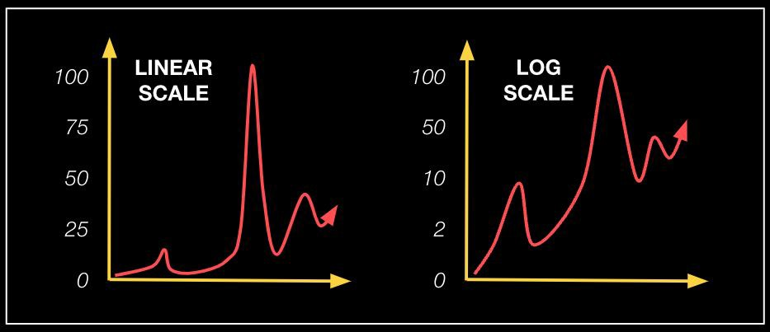
@anilsaidso

Slide 43

10x IMPROVEMENT RULE
New technologies must oﬀer a beneﬁt ten times greater than a predecessor or substitutes to gain widespread adoption
@anilsaidso

Slide 44
“As a good rule of thumb, proprietary technology must be at least 10 times better than its closest substitute in some important dimension to lead to a real monopolistic advantage.”
—PETER THIEL

Slide 45
NETWORK EFFECTS
The Bitcoin Handbook
The phenomena whereby each additional user to a network adds disproportionately more value and utility
@anilsaidso

Slide 46
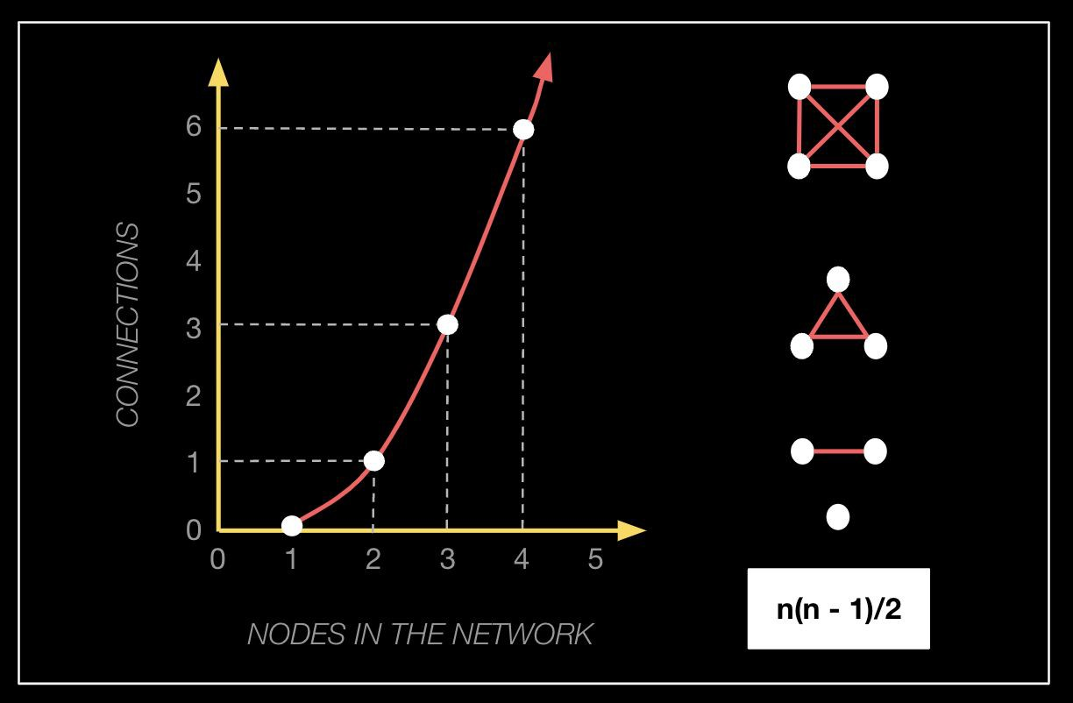
@anilsaidso

Slide 47

CHURN
The Bitcoin Handbook
The rate of user attrition, often expressed as a percentage
@anilsaidso

Slide 48
# Non-zero bitcoin Addresses
40M
30M
20M
10M
@anilsaidso
source: Glassnode
0
2010
2012
2014
2016
2018
2020
2022

Slide 49
ACCELERATING RETURNS
The Bitcoin Handbook
The rate of technological change is exponential, resulting in ever-increasing innovation and disruption
@anilsaidso

Slide 50
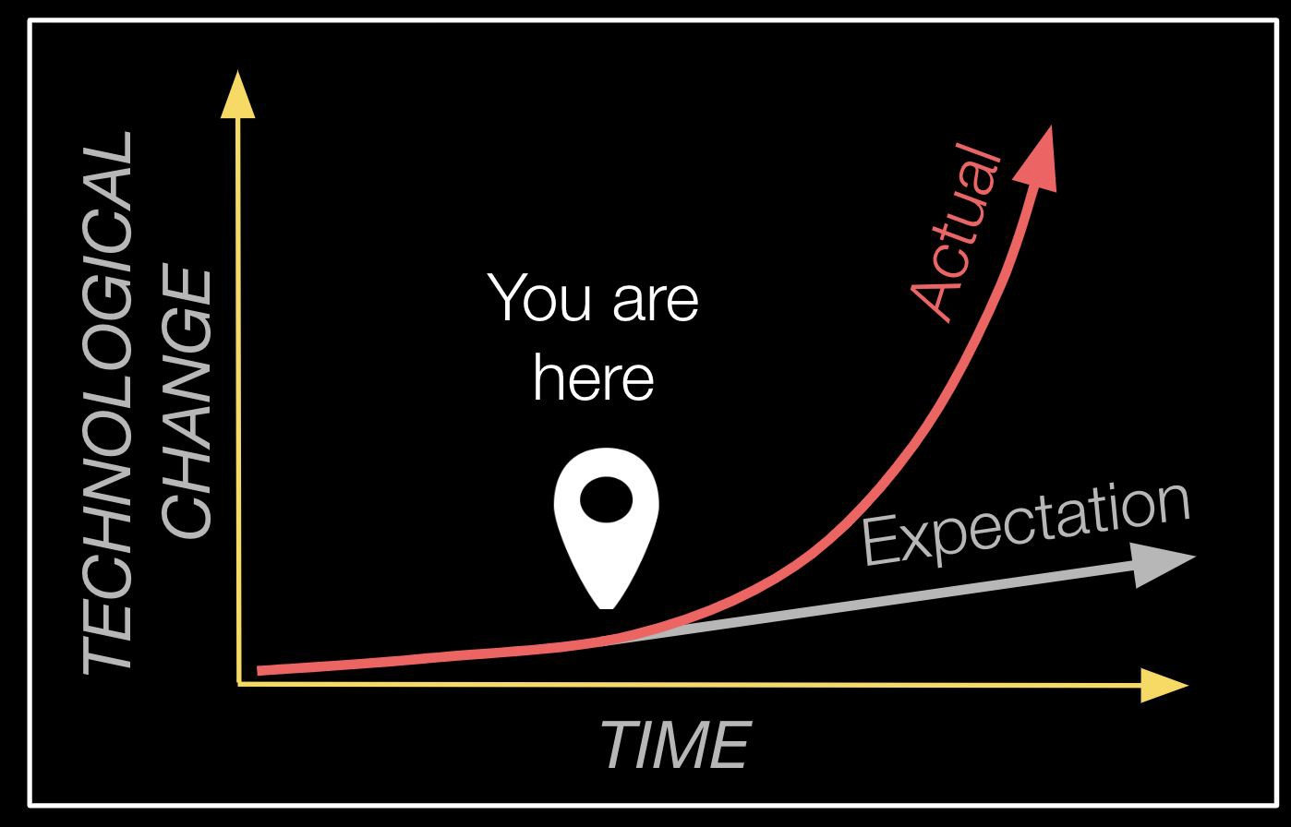
@anilsaidso

Slide 51

HIGHER-ORDER EFFECTS
The Bitcoin Handbook
Actions have consequences. And those consequences have consequences.
@anilsaidso

Slide 52
3rd Order
2nd Order
1st Order
ACTION
@anilsaidso

Slide 53
“Many people look at ﬁrst order eﬀects, thinking in the short term. Conversely, not spending time considering the 2nd and 3rd order eﬀects of actions—which leads them to put too much trust in a system that will ultimately fail.”
—JEFF BOOTH

Slide 54
CREATIVE DESTRUCTION
The Bitcoin Handbook
The cycle of entrepreneurs out-innovating and obsoleting
incumbents, under a free-market
@anilsaidso

Slide 55
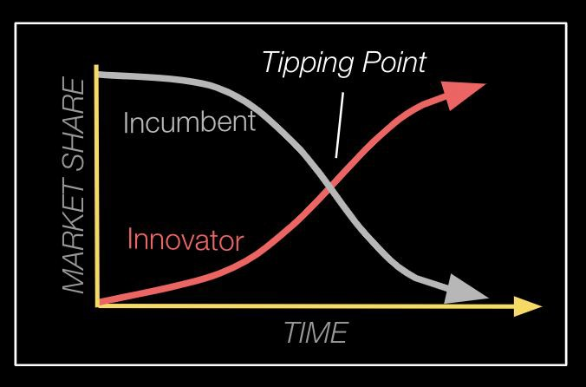
@anilsaidso

Slide 56
FEEDBACK LOOPS
The Bitcoin Handbook
A system that reacts to its environment and the resultant output gets re-incorporated as an input
@anilsaidso

Slide 57
REFLEXIVITY
The Bitcoin Handbook
The circular relationship between market participants and market sentiment, whereby attributing the respective impact of either is diﬃcult
@anilsaidso

Slide 58



PRICE
@anilsaidso
FUNDAMENTALS
PERCEPTION

Slide 59
RELATIVITY
The Bitcoin Handbook
When you’re a part of a system, it can be diﬃcult to zoom out to gain perspective
@anilsaidso

Slide 60
FIAT STANDARD
@anilsaidso
Past
Future
GOLD STANDARD
BITCOIN STANDARD
Present

Slide 61

THERMODYNAMICS
1st LAW
The Bitcoin Handbook
0000000000000
000000592a974
b1b9f087cb776 28bb4a097d5c2 c11b3476a58e
Energy cannot be created nor destroyed in isolated systems. It can only be transformed
@anilsaidso

Slide 62
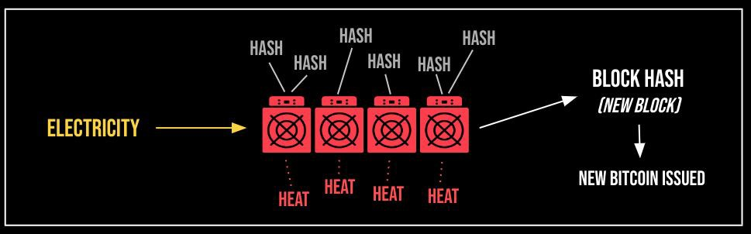
@anilsaidso

Slide 63
THERMODYNAMICS ^{2nd LAW}
The Bitcoin Handbook
The entropy of the universe always increases with time.
@anilsaidso

Slide 64
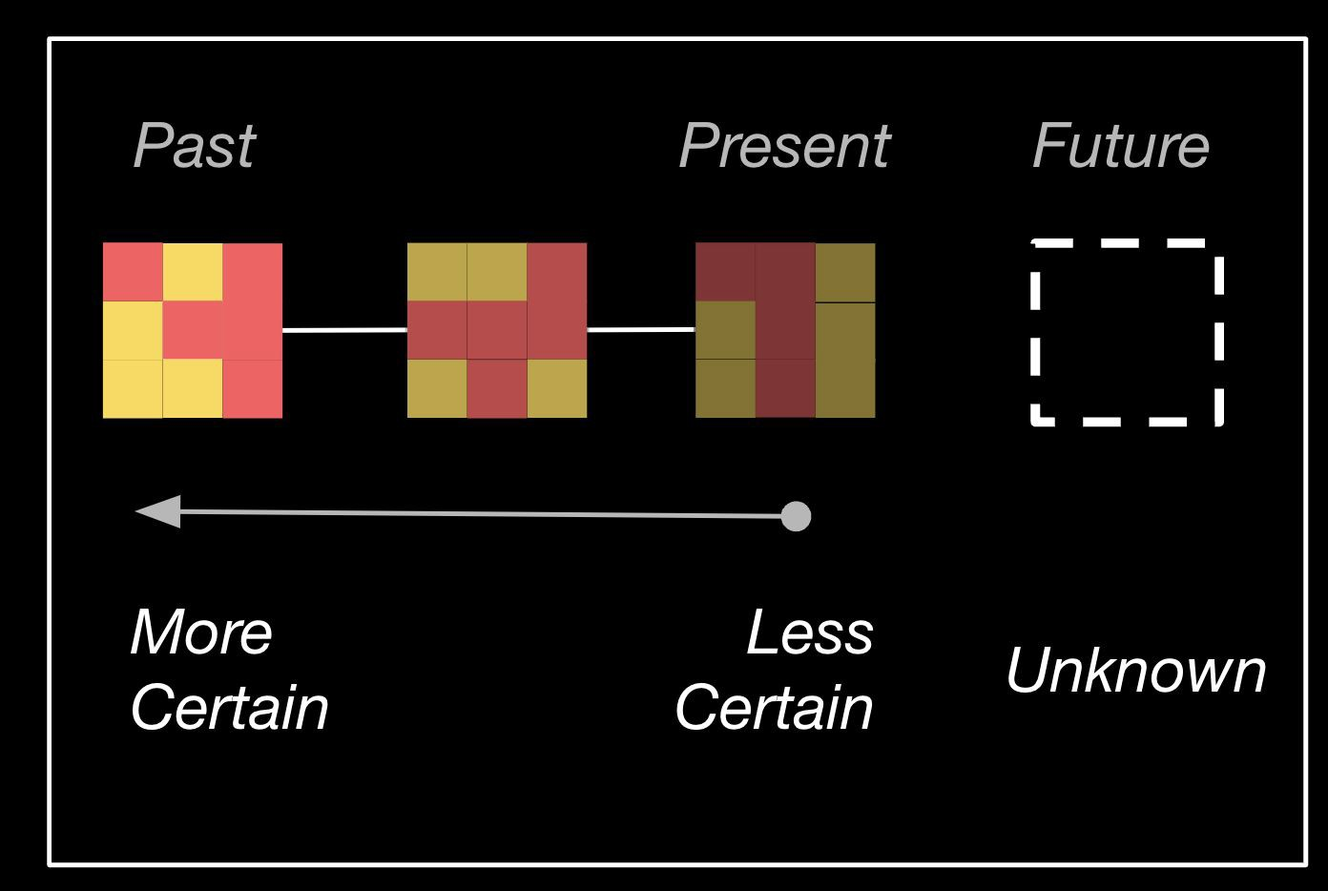
@anilsaidso

Slide 65

ARROW OF TIME
The Bitcoin Handbook
Establishing the one-way direction of time by distinguishing past from present.
@anilsaidso

Slide 66

INFORMATION THEORY
The Bitcoin Handbook
010010110
How digital information is communicated, stored, and quantiﬁed.
1010111
@anilsaidso

Slide 67
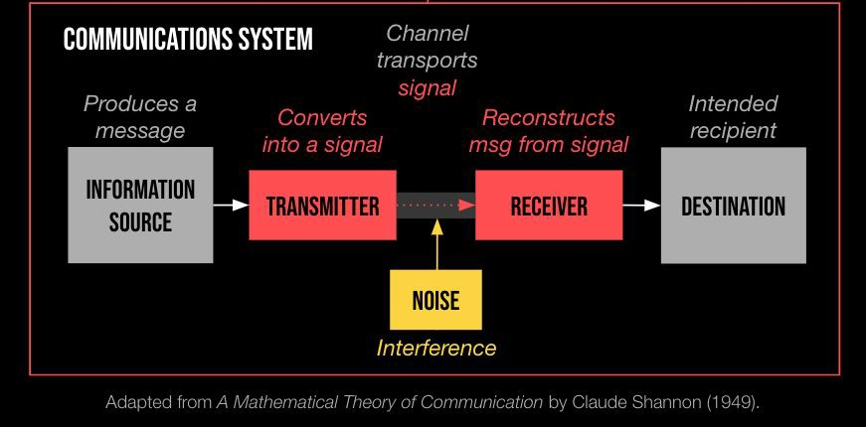

Slide 68
"The fundamental problem of communication is that of reproducing at one point, either exactly or approximately, a message selected at another point."
—CLAUDE SHANNON

Slide 69

MOORE’s LAW
The Bitcoin Handbook
The observation that the number of transistors on a computer chip doubles approximately every two years
@anilsaidso

Slide 70
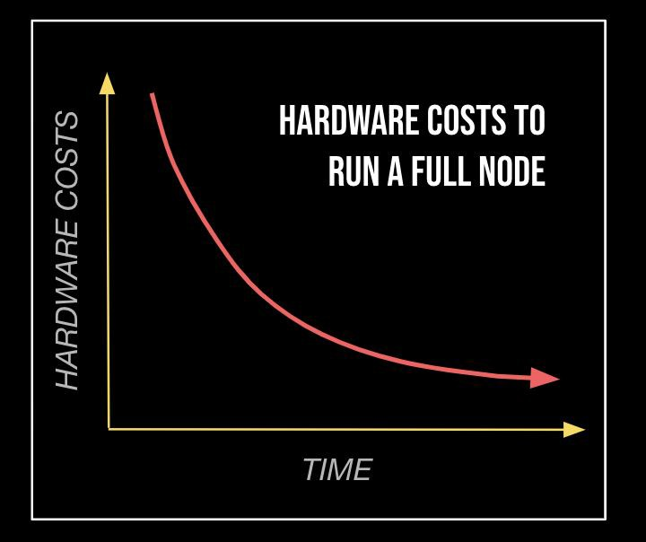
@anilsaidso

Slide 71

ANTIFRAGILITY
The Bitcoin Handbook
Things that actively gain from volatility and unpredictability by using rapid feedback loops to evolve
@anilsaidso

Slide 72
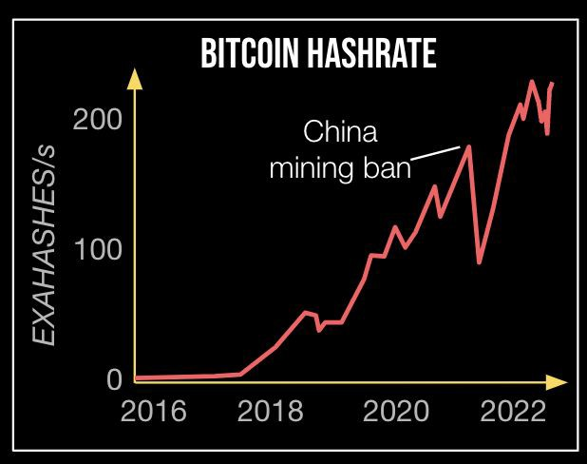
@anilsaidso

Slide 73

GALL’S LAW
The Bitcoin Handbook
Incremental improvements made to a functional system is a superior strategy to building a complex system from scratch
@anilsaidso

Slide 74
“Bitcoin is too important to follow the Silicon Valley mantra of move fast and break things. Instead, it’s move slowly and don’t break anything.
If a global ﬁnancial system is to be built on a decentralized monetary system, the foundation must be protected at all cost.”
—PARKER LEWIS

Slide 75

ATTACK SURFACE
The Bitcoin Handbook
The sum of all potential vulnerabilities from all potential access points
@anilsaidso

Slide 76
CAmount GetBlockSubsidy(int nHeight, const
Consensus::Params& consensusParams)
{
int halvings = nHeight /
consensusParams.nSubsidyHalvingInterval;
// Force block reward to zero when right shift is undefined.
if (halvings >= 64)
return 0;
CAmount nSubsidy = 50 * COIN;
// Subsidy is cut in half every 210,000 blocks which will occur approximately every 4 years.
nSubsidy >>= halvings;
return nSubsidy;
}
@anilsaidso

Slide 77
“Being open source means anyone can independently review the code. If it was closed source, nobody could verify the security.”
—SATOSHI NAKAMOTO

Slide 78



CATALYSTS
The Bitcoin Handbook
Kick-starts a reaction but isn’t itself a reactant
@anilsaidso

Slide 79

FRICTION
The Bitcoin Handbook
A force that opposes the relative movement of something
@anilsaidso

Slide 80
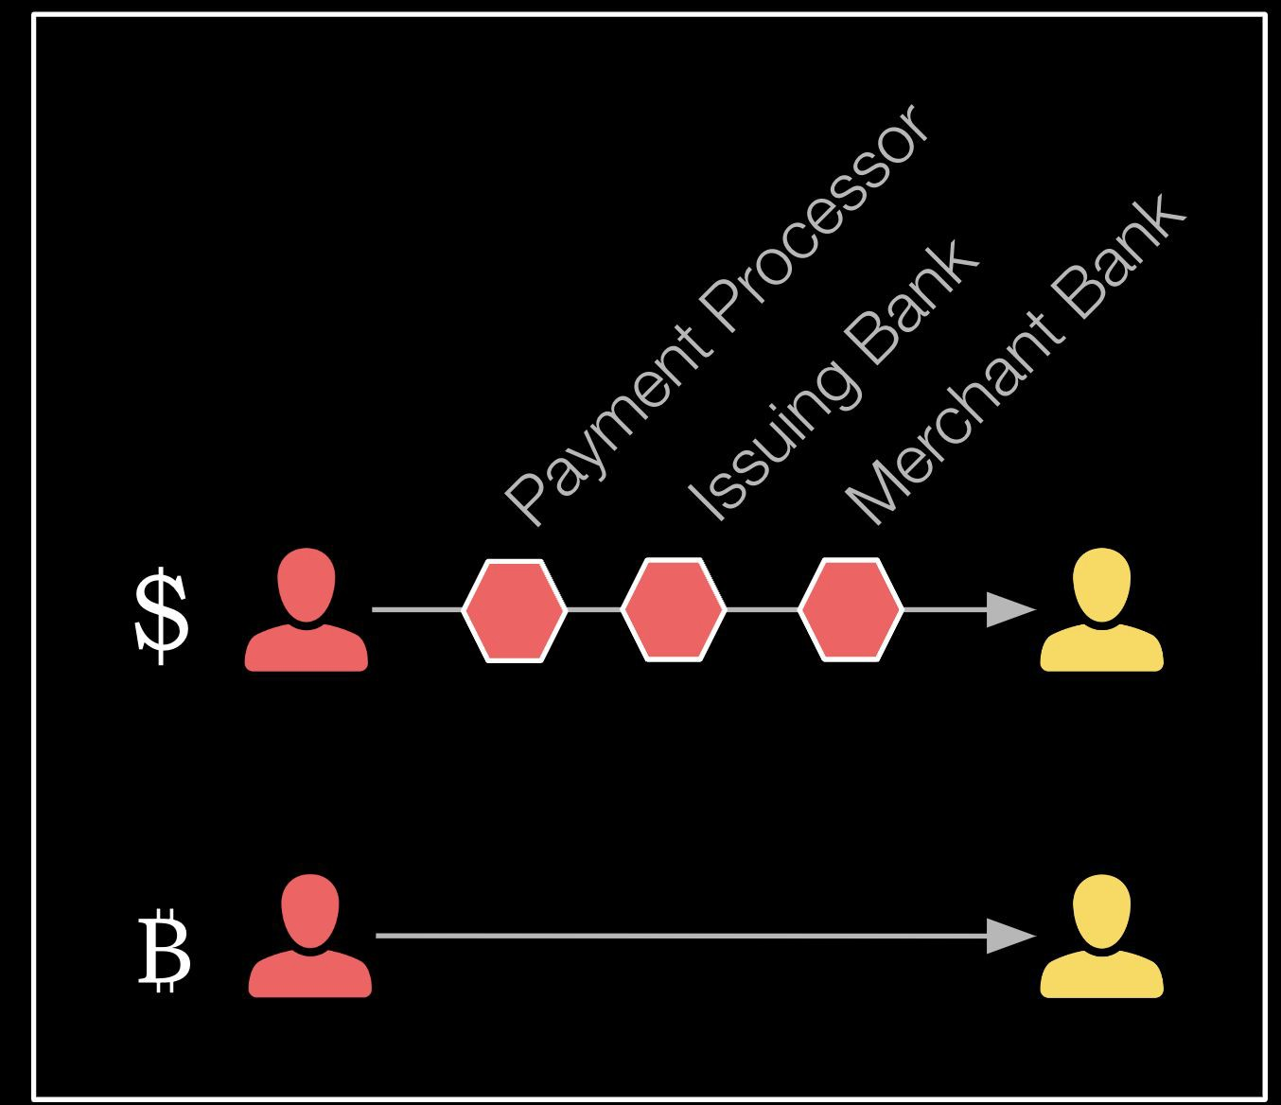
@anilsaidso

Slide 81
Psychology

Slide 82
PRISONER’S DILEMMA
The Bitcoin Handbook
Using math to determine if it’s better to cooperate or compete in multiplayer games
@anilsaidso

Slide 83
“If bitcoin adoption increases, the countries that secure some bitcoin today will be better oﬀ competitively than their peers. Therefore, even if other countries do not believe in the investment thesis.., they will be forced to acquire some as a form of insurance.”
—Chris Kuiper & Jack Neureuter

Slide 84

JURISDICTIONAL ARBITRAGE
The Bitcoin Handbook
Taking advantage of discrepancies between competing legal jurisdictions
@anilsaidso

Slide 85
SOCIAL PROOF
The Bitcoin Handbook
In uncertain situations we look to those we deem knowledgeable or competent for guidance
@anilsaidso

Slide 86
“Paul Tudor Jones validates
it for other hedge fund managers, hedge fund managers validate it for sovereign-wealth funds, sovereign-wealth funds will validate it for
central banks.”
—NAVAL RAVIKANT

Slide 87

MIMETIC THEORY
The Bitcoin Handbook
Our desires are not intrinsic, but derived from the desires of others that we seek to imitate
@anilsaidso

Slide 88
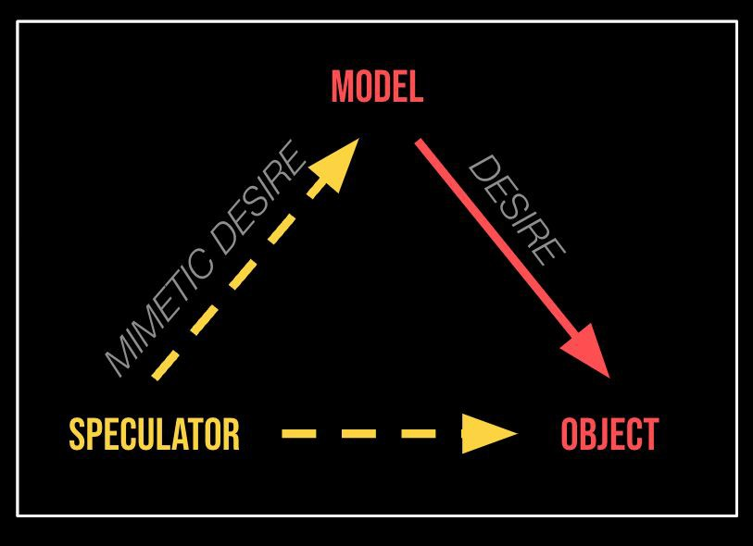
@anilsaidso

Slide 89

FIRST CONCLUSION BIAS
The Bitcoin Handbook
The tendency to accept the ﬁrst answer oﬀered, regardless of correctness, shutting out any further inquiry or debate
@anilsaidso

Slide 90
“The mind works a bit like a sperm and egg: the ﬁrst idea gets in and then the mind shuts… leads us to accept many erroneous results.”
—CHARLIE MUNGER

Slide 91
CIRCLE OF COMPETENCE
The Bitcoin Handbook
Understanding where your knowledge is lacking will illuminate where you’re vulnerable
@anilsaidso

Slide 92

@anilsaidso

Slide 93

DUNNING-KRUGER EFFECT
The Bitcoin Handbook
Overestimating your knowledge in a speciﬁc area leads to erroneous decisions
@anilsaidso

Slide 94
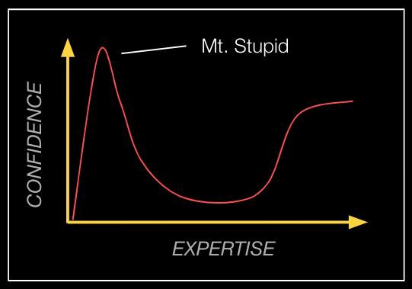
@anilsaidso

Slide 95
CATEGORY ERROR
The Bitcoin Handbook
Assuming an individual property of something is representative of its whole, leading to misattribution
@anilsaidso

Slide 96







Store of Value
Commodity
@anilsaidso
Payment Rail
Unit of Account
Software
Network

Slide 97
GARTNER HYPE CYCLE
The Bitcoin Handbook
A methodology for ascertaining the maturity and adoption of new technologies and applications
@anilsaidso

Slide 98
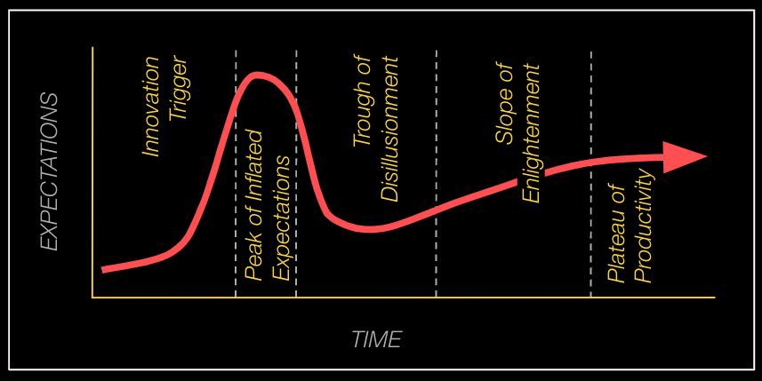
@anilsaidso

Slide 99
AMARA’s LAW
We tend to overestimate the impact of new technologies in the short term and underestimate it in the long term
@anilsaidso

Slide 100
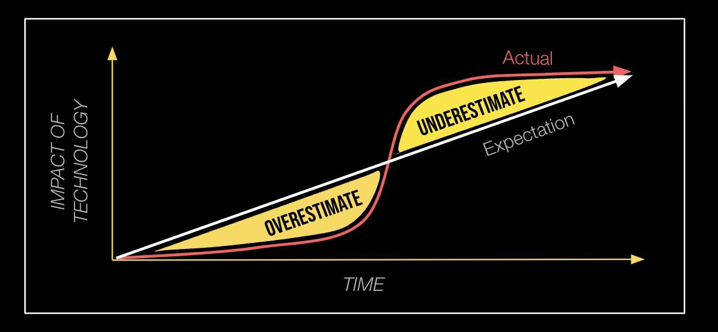
@anilsaidso

Slide 101
INTRANSIGENT MINORITY
The Bitcoin Handbook
When a few individuals shape the preferences of the majority by their unwillingness to submit to the default option
@anilsaidso

Slide 102
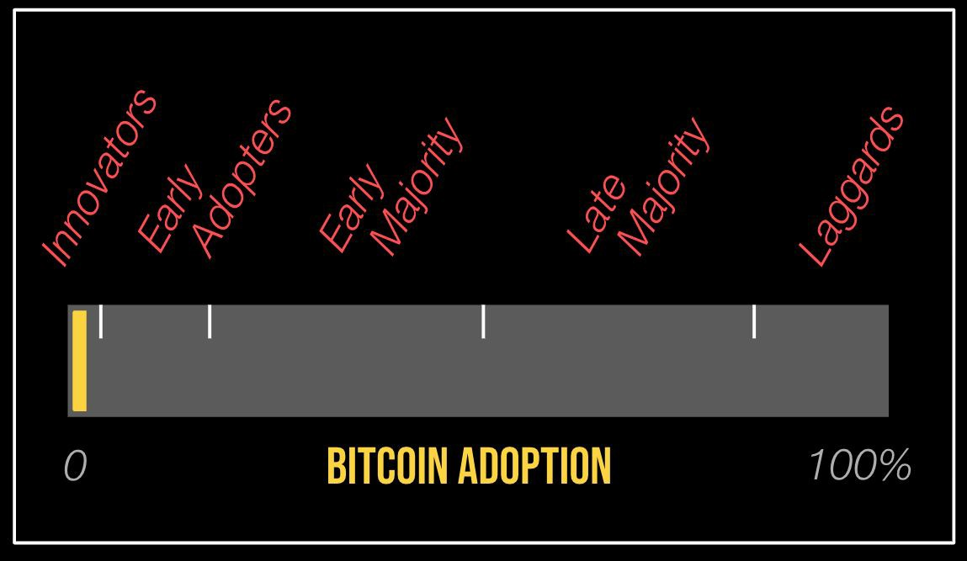
@anilsaidso

Slide 103

INEQUIVALENCE THEOREM
The Bitcoin Handbook
When economic conditions become excessively burdensome, individuals with the capacity will permanently exit a jurisdiction
@anilsaidso

Slide 104
“In the Information Age.. the rational person will not respond to the prospect of higher taxes to fund deﬁcits..
Sovereign individuals and other rational people will ﬂee jurisdictions with large unfunded liabilities.”
—JAMES DALE DAVIDSON & WILLIAM REES-MOGG
THE
SOVEREIGN
INDIVIDUAL

Slide 105

Gell-mann amnesia
The Bitcoin Handbook
Observing errors in reporting of a topic, yet trusting the same source in areas where you are less knowledgeable
@anilsaidso

Slide 106
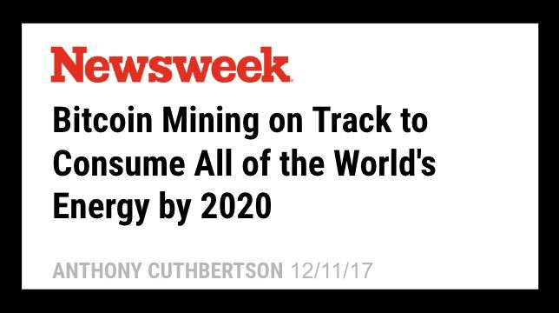

Slide 107
THE LINDY EFFECT
The Bitcoin Handbook
The theory that the lifespan of non-perishable things are proportional to their current age
@anilsaidso

Slide 108
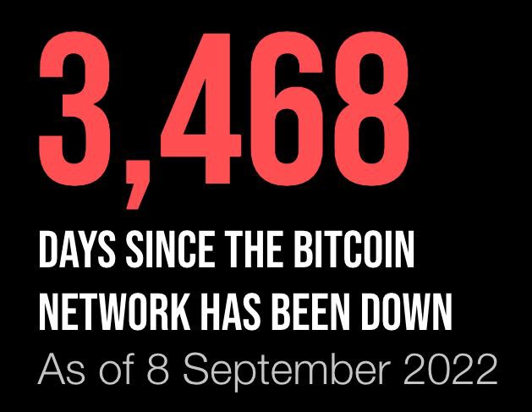
@anilsaidso

Slide 109
EMERGENCE
The Bitcoin Handbook
When novel dynamic structures arise from the interaction of individual components and becomes self-regulating
@anilsaidso

Slide 110
“Bitcoin is currently transitioning from the ﬁrst stage of monetization to the second stage.. No one alive has seen the real-time monetization of a good (as is taking place with Bitcoin), so there is precious little experience regarding the path this monetization will take.”
—VIJAY BOYAPATI
@anilsaidso
Store of Value
Medium of Exchange
Unit of Account
Collectible

Slide 111

STREISAND EFFECT
The Bitcoin Handbook
Attempting to hide, remove, or censor something has the unintended consequence of publicizing it more widely
@anilsaidso

Slide 112
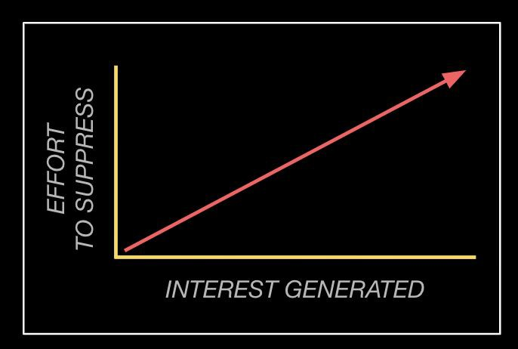
@anilsaidso

Slide 113
MORAL HAZARD
The Bitcoin Handbook
When a party has a duty to serve the interests of others, but instead places its own interests ﬁrst
@anilsaidso

Slide 114
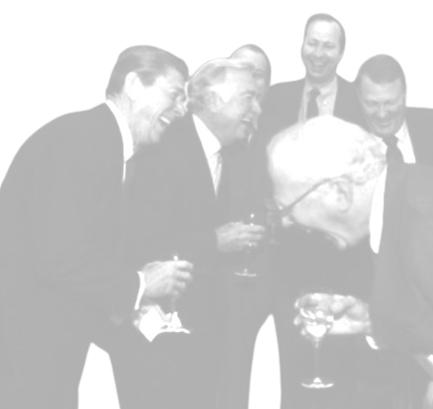
“The root problem with conventional currency is all the trust that’s required to make it work. The central bank must be trusted not to debase the currency, but the history of ﬁat currencies is full of breaches of that trust.”
—SATOSHI NAKAMOTO

Slide 115

COUNTERPARTY RISK
The Bitcoin Handbook
The likelihood of a party defaulting on its obligation in a transaction
@anilsaidso

Slide 116
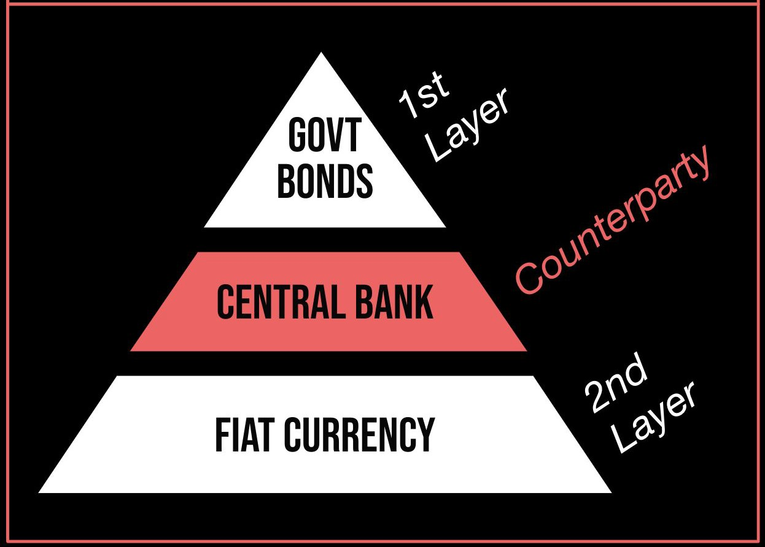
@anilsaidso
Adapted from Layered Money by Nik Bhatia

Slide 117
Anil Patel
@anilsaidso

